Slide 1
OPTION TRADING USING MACHINE LEARNING

Slide 2
WHAT IS OPTION TRADING

Slide 3
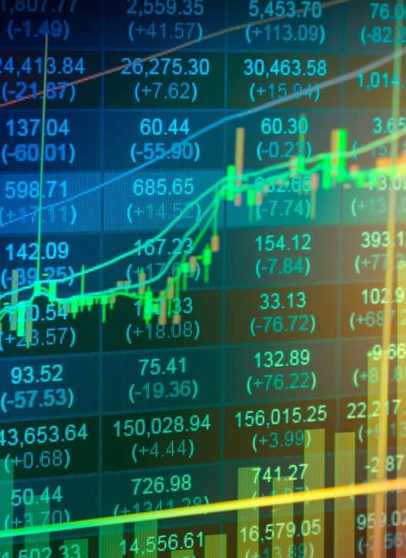
THE NEED OF OUR PROJECT IN TRADING

Slide 4
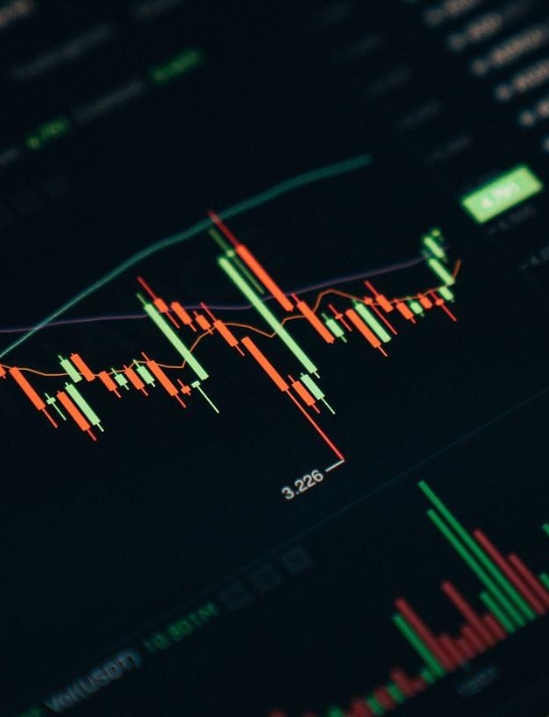
BANK NIFTY
stock market index

Slide 5
CAPITALIZATION-WEIGHT OF BANK NIFTY
The 12 banking stocks that make up the Bank Nifty index are selected based on their market capitalization, liquidity, and trading frequency.
The weightage of each stock in the index is calculated based on its market capitalization. The weightage is determined by dividing the market capitalization of each stock by the total market capitalization of all 12 stocks.

Slide 6
WHY WE CHOOSE BANK NIFTY?
Hdfc bank & Icici Bank

Slide 7
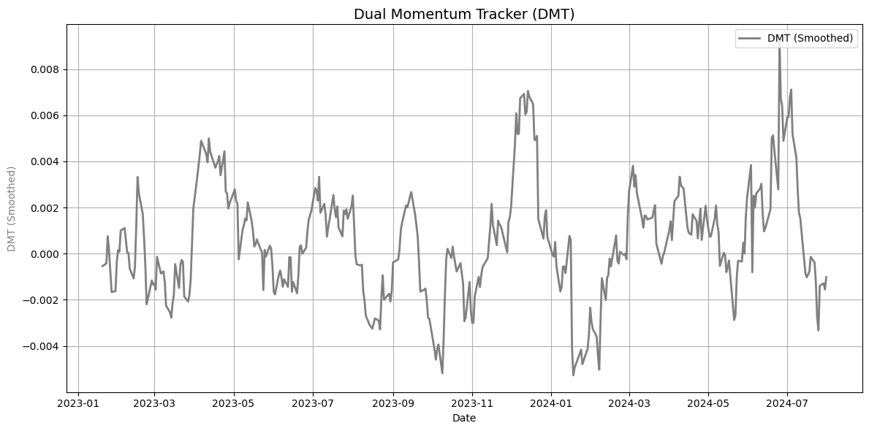
DUAL MOMENTUM TRACKER(DMT)

Slide 8
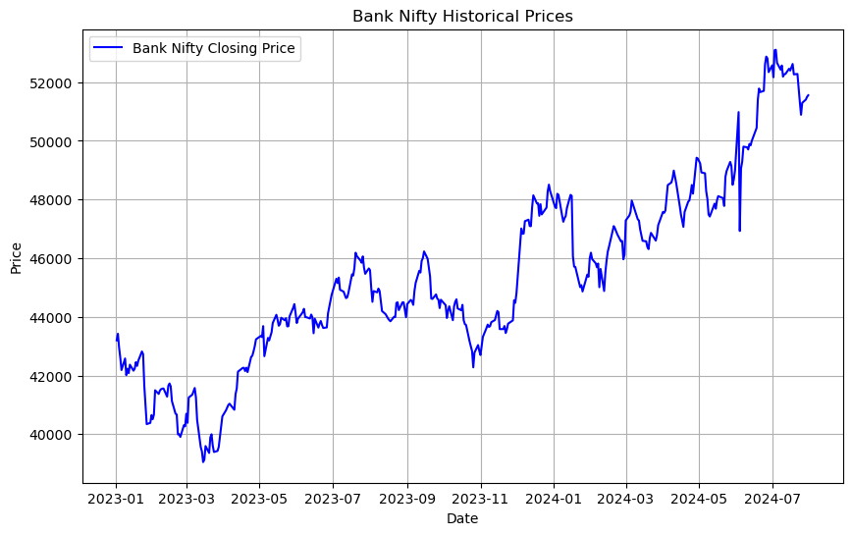
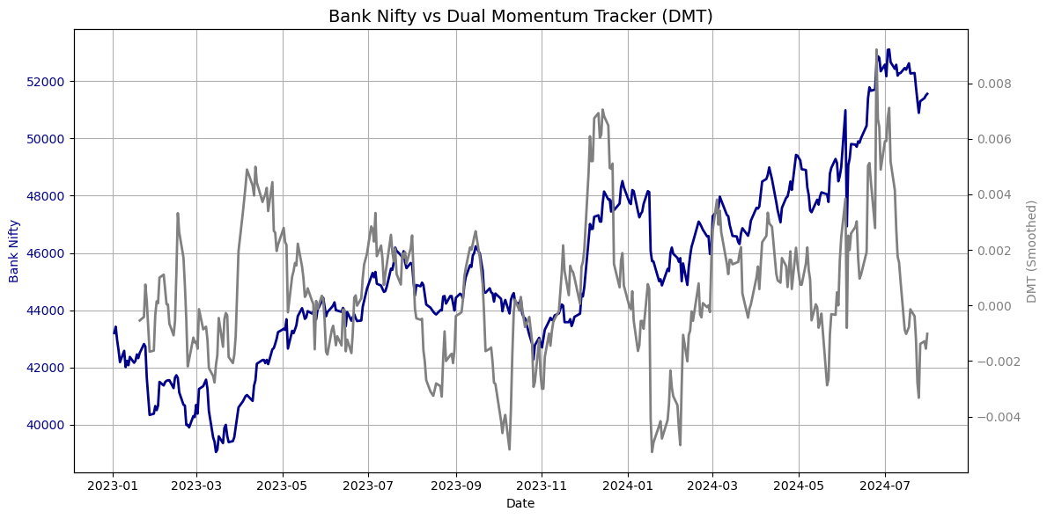
BANK NIFTY AND DMT INDICATOR WITH BANK NIFTY

Slide 9
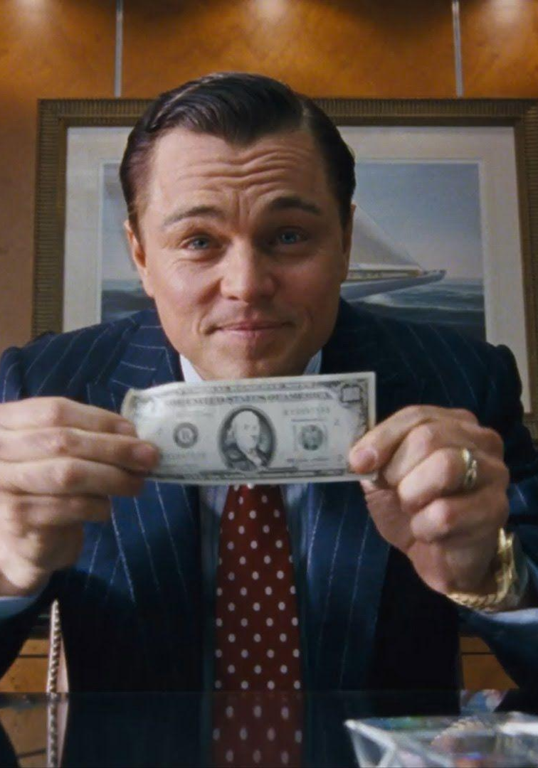
LETS DIVE INTO THE IMPLEMENTATION ☺

Slide 10
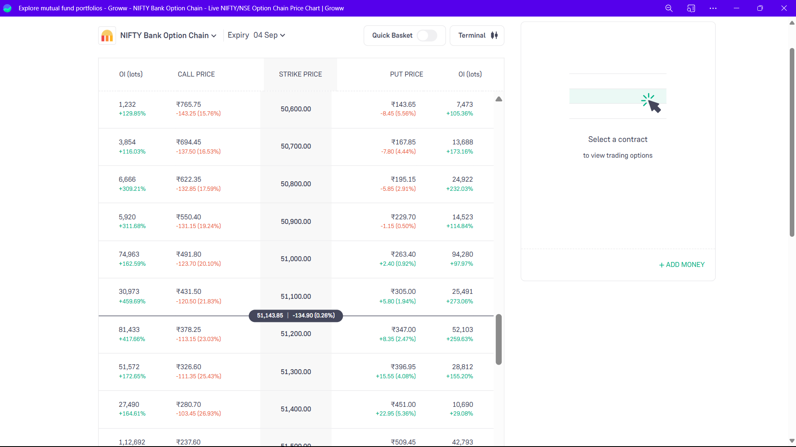
CALL AND PUT OPTION
These two are the basic gateway that you should know to know about the indicator.
 |  | TARGET | ACTUAL
 |  | 150 | 120
Engagemnt duration | Minutes | 60 | 75
Q&A interaction | # of questions | 10 | 15
Positive feedback | Percentage (%) | 90 | 95
Rate of information retention | Percentage (%) | 80 | 85

Slide 11
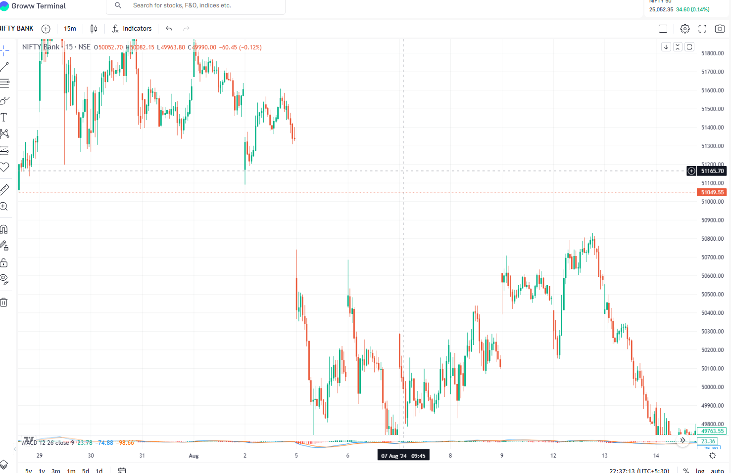
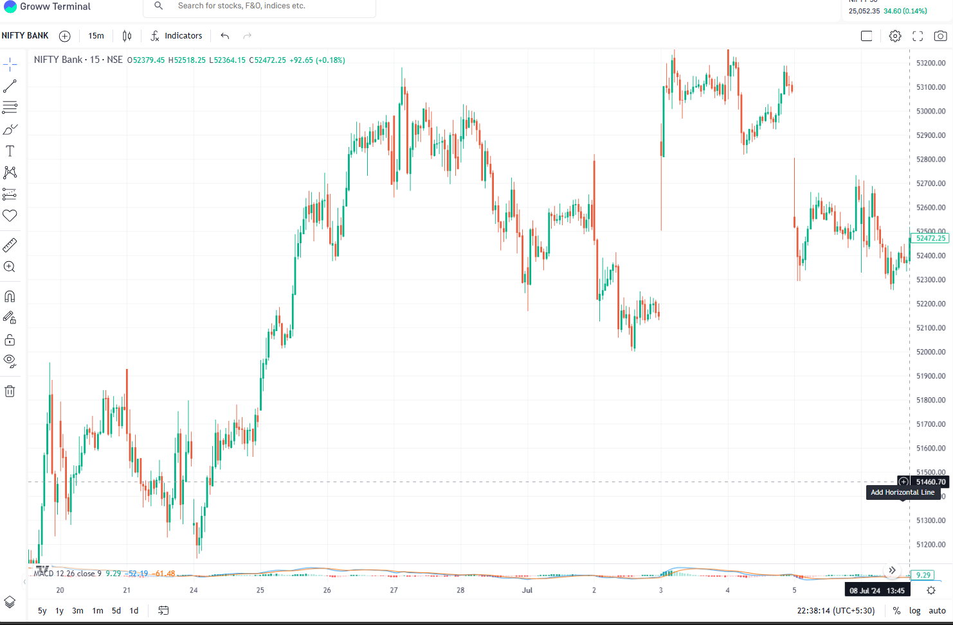
UP TREND AND DOWN TREND

Slide 12
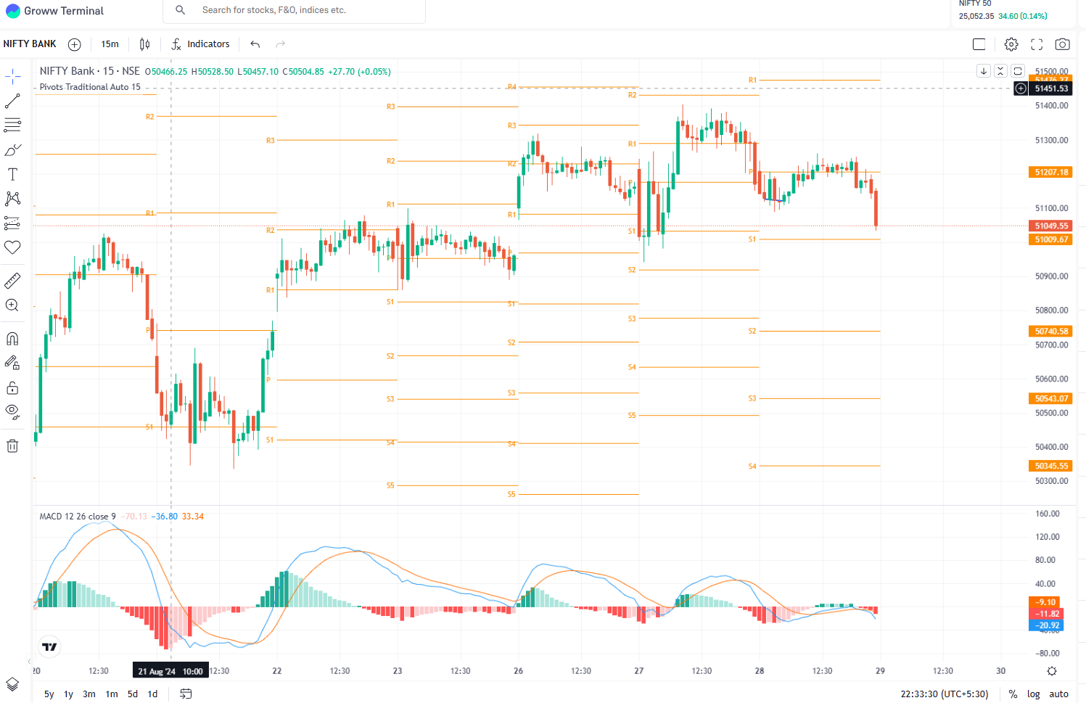

Slide 13
THANK YOU
Batch-C6
Suraj kumar panda
DIVYA THAMMANA
D.AANANDINI

